Slide 1
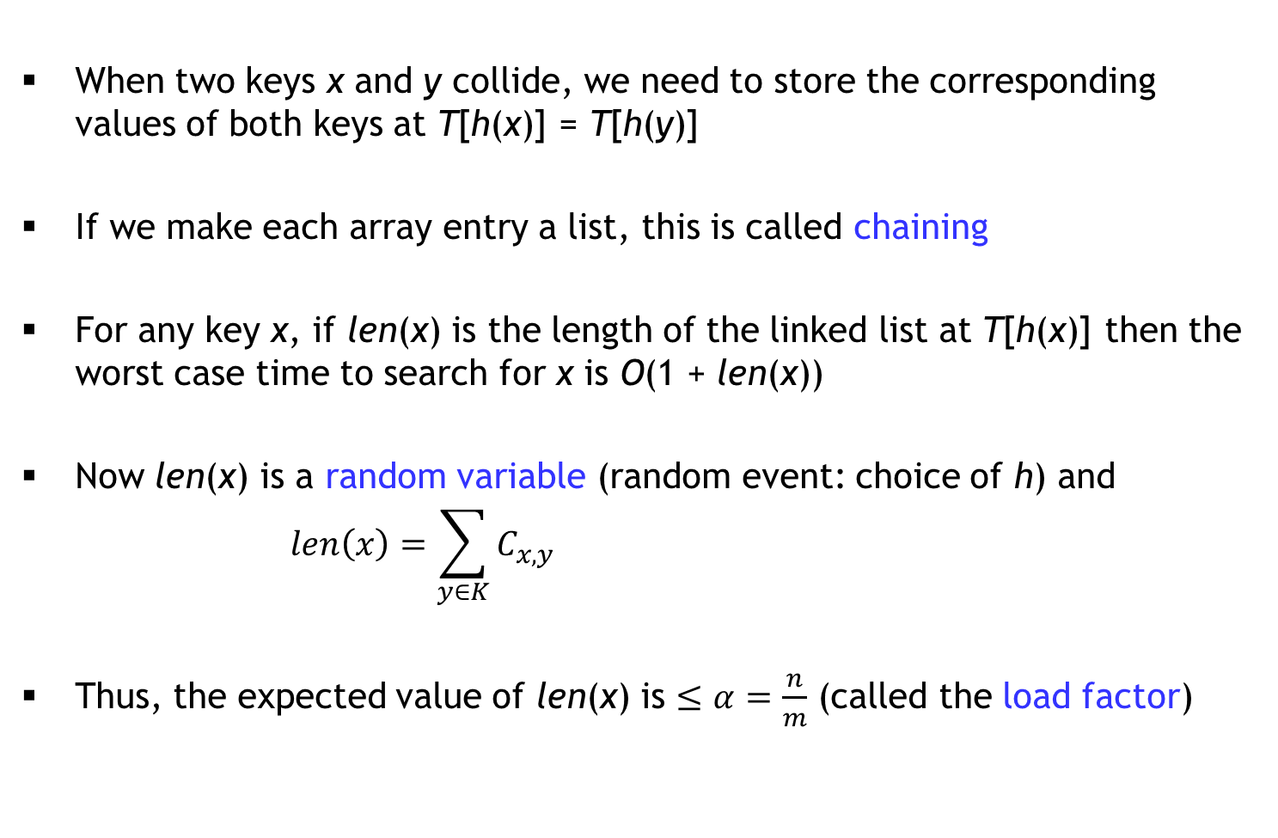

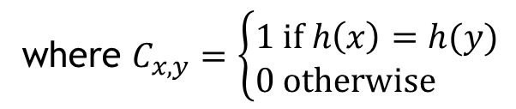
Chaining
When two keys x and y collide, we need to store the corresponding values of both keys at T[h(x)] = T[h(y)]
If we make each array entry a list, this is called chaining
For any key x, if len(x) is the length of the linked list at T[h(x)] then the worst case time to search for x is O(1 + len(x))
Now len(x) is a random variable (random event: choice of h) and
$$len\left(x\right)=\sum_{y∈K}{C_{x,y}}$$
Thus, the expected value of len(x) is $≤α=\frac{n}{m}$ (called the load factor)
where $C_{x,y}=\left\{\begin{matrix}1 if h\left(x\right)=h(y) \\ 0 otherwise \end{matrix}\right.$
prob.$≤\frac{1}{m}$

Slide 2
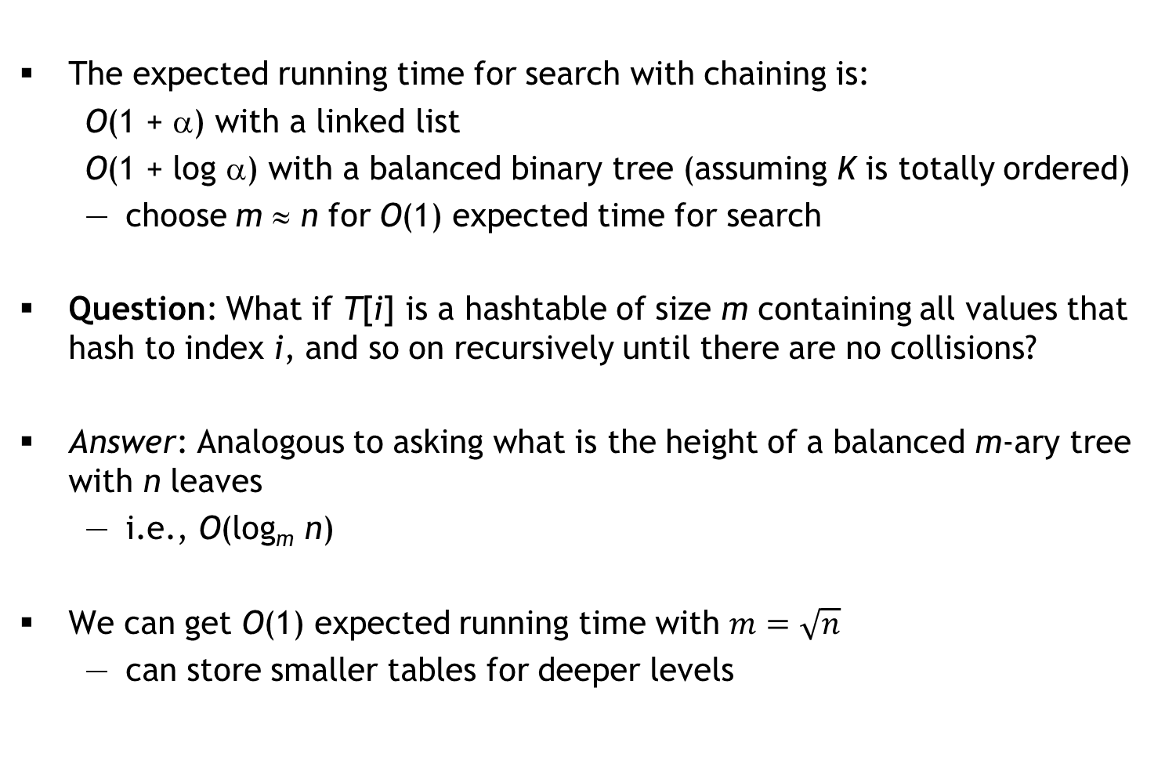
Advanced Chaining
The expected running time for search with chaining is:
O(1 + α) with a linked list
O(1 + log α) with a balanced binary tree (assuming K is totally ordered)
choose m ≈ n for O(1) expected time for search
Question: What if T[i] is a hashtable of size m containing all values that hash to index i, and so on recursively until there are no collisions?
Answer: Analogous to asking what is the height of a balanced m-ary tree with n leaves
i.e., O(log_{m} n)
We can get O(1) expected running time with $m=\sqrt{n}$
can store smaller tables for deeper levels

Slide 3
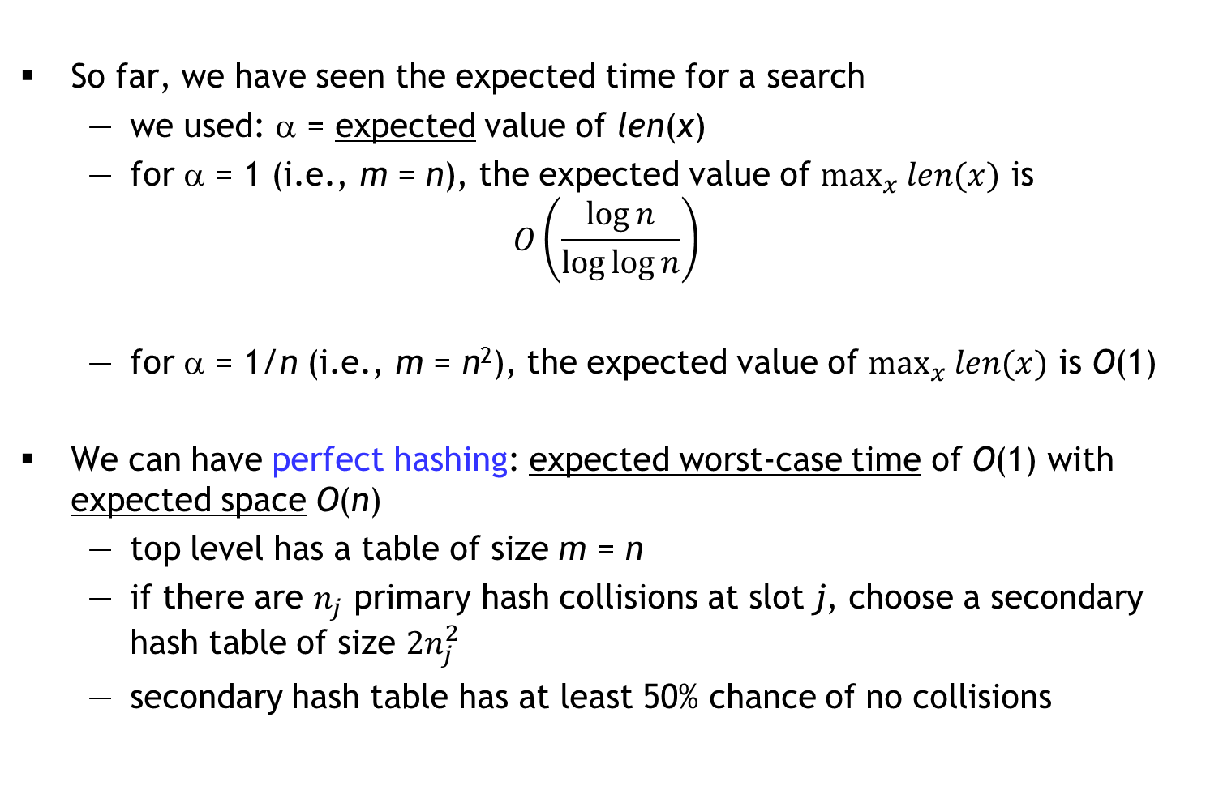
Expected worst case
So far, we have seen the expected time for a search
we used: α = expected value of len(x)
for α = 1 (i.e., m = n), the expected value of $\max_{x} len(x)$ is
$$O\left(\frac{\log{n}}{\log{\log{n}}}\right)$$
for α = 1/n (i.e., m = n²), the expected value of $\max_{x} len(x)$ is O(1)
We can have perfect hashing: expected worst-case time of O(1) with expected space O(n)
top level has a table of size m = n
if there are $n_{j}$ primary hash collisions at slot j, choose a secondary hash table of size $2n_{j}^{2}$
secondary hash table has at least 50% chance of no collisions

Slide 4
Open Addressing: an alternative to chaining
Suppose we want to hash keys in K to {0, 1, …, m − 1}
each entry T[i] will contain one (key, value) pair or it will be empty
Instead of a single hash function h, we have a sequence of hash functions h₀, h₁, …, h_{m − 1} such that ∀x ∈ K
the probe sequence h₀(x), h₁(x), …, h_{m − 1}(x)
is a permutation of 0, 1, …, m − 1
We search for an item x at indices according to the probe sequence
we stop when we find x or an empty slot
hopefully, we don’t need too much of the probe sequence
Ideal case (strong uniform hashing): For any x, the probe sequence is equally likely to be any of the permutations of 0, 1, …, m − 1

Slide 5
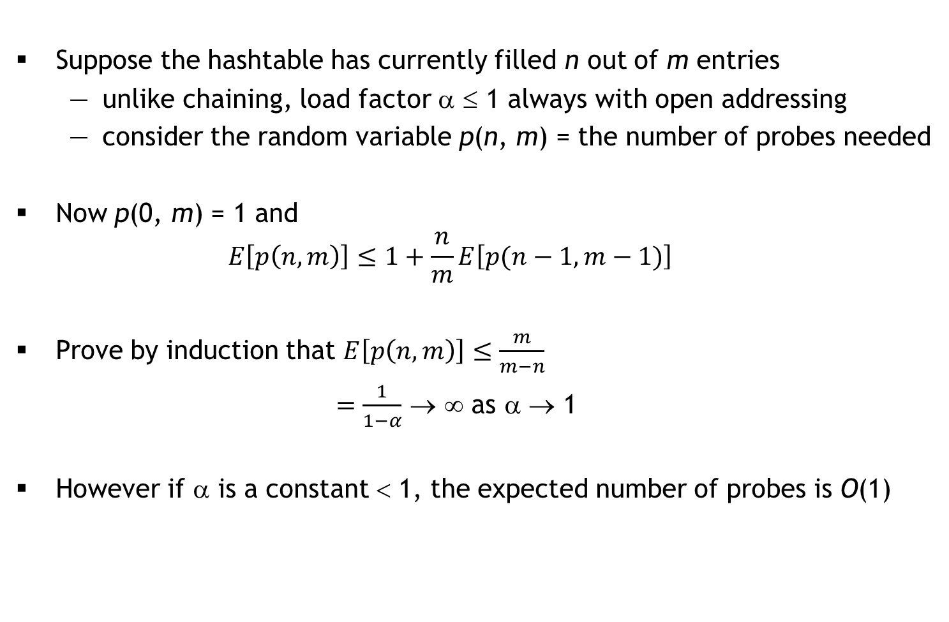
Analysis with strong uniform hashing assumption
Suppose the hashtable has currently filled n out of m entries
unlike chaining, load factor α ≤ 1 always with open addressing
consider the random variable p(n, m) = the number of probes needed
Now p(0, m) = 1 and
$$E\left[p\left(n,m\right)\right]≤1+\frac{n}{m}E\left[p(n−1,m−1)\right]$$
Prove by induction that $E\left[p\left(n,m\right)\right]≤\frac{m}{m−n}$
$=\frac{1}{1−α}$ → ∞ as α → 1
However if α is a constant < 1, the expected number of probes is O(1)

Slide 6
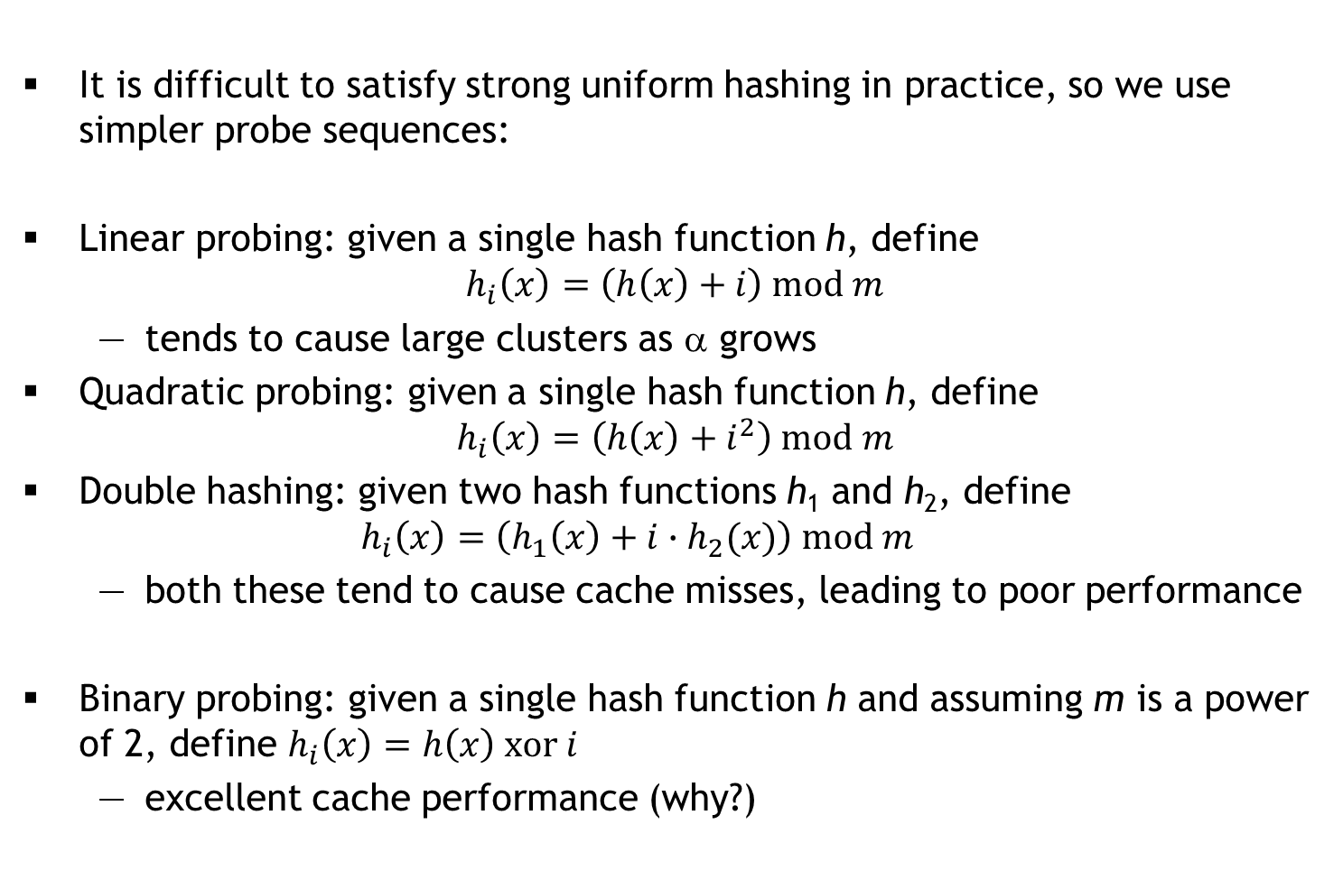
Common Probe Sequences
It is difficult to satisfy strong uniform hashing in practice, so we use simpler probe sequences:
Linear probing: given a single hash function h, define
$$h_{i}\left(x\right)=\left(h\left(x\right)+i\right) mod m$$
tends to cause large clusters as α grows
Quadratic probing: given a single hash function h, define
$$h_{i}\left(x\right)=\left(h\left(x\right)+i^{2}\right) mod m$$
Double hashing: given two hash functions h₁ and h₂, define
$$h_{i}\left(x\right)=\left(h_{1}\left(x\right)+i∙h_{2}(x)\right) mod m$$
both these tend to cause cache misses, leading to poor performance
Binary probing: given a single hash function h and assuming m is a power of 2, define $h_{i}\left(x\right)=h\left(x\right) xor i$
excellent cache performance (why?)

Slide 7
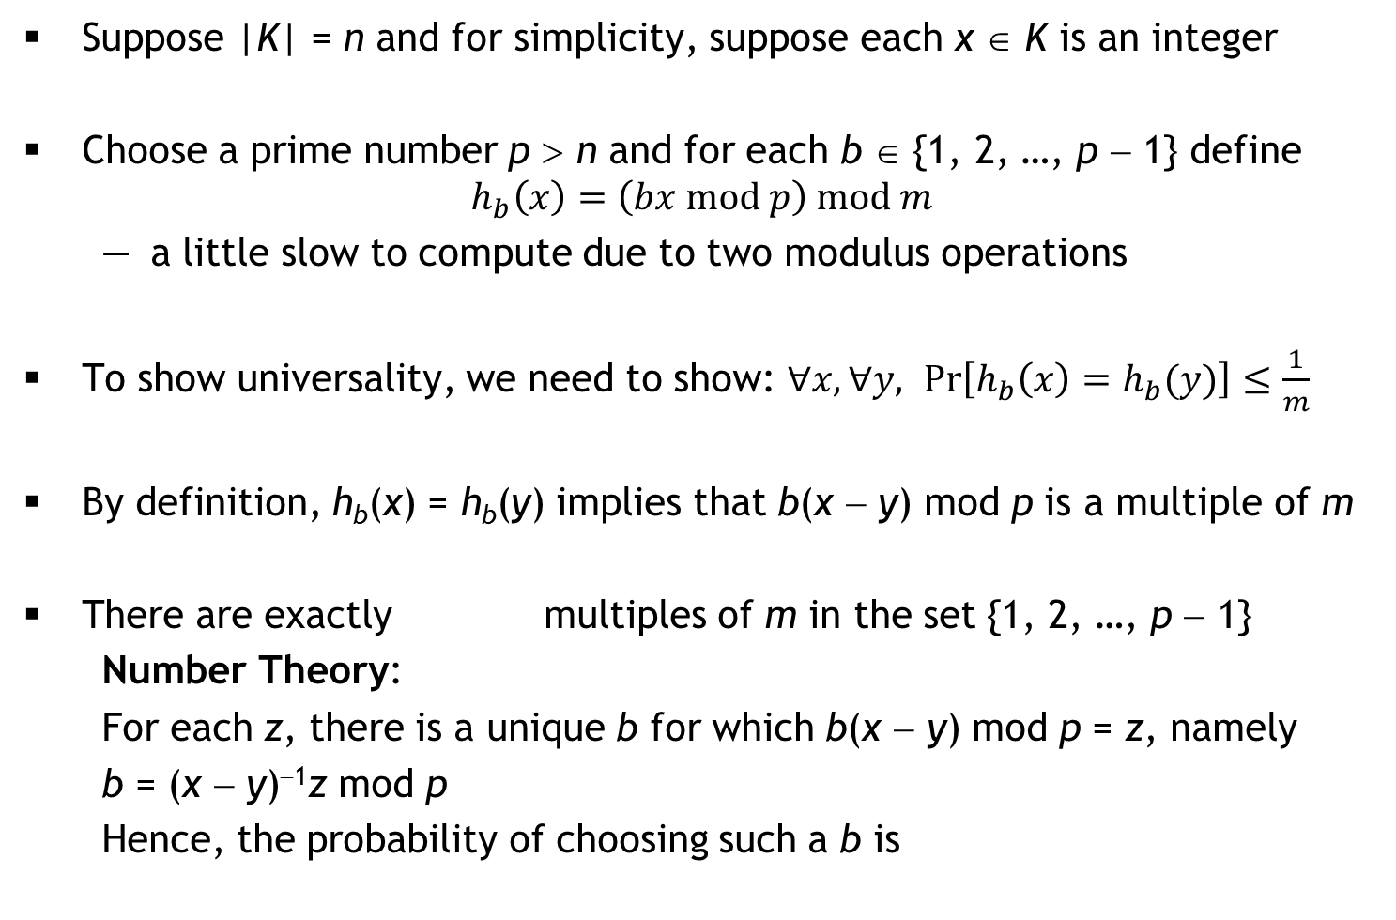

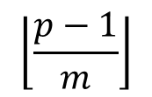
Prime Multiplicative Hash Family
Suppose |K| = n and for simplicity, suppose each x ∈ K is an integer
Choose a prime number p > n and for each b ∈ {1, 2, …, p − 1} define
$$h_{b}\left(x\right)=\left(bx mod p\right) mod m$$
a little slow to compute due to two modulus operations
To show universality, we need to show: $∀x, ∀y, \operatorname{Pr}\left[h_{b}\left(x\right)=h_{b}(y)\right]≤\frac{1}{m}$
By definition, h_{b}(x) = h_{b}(y) implies that b(x − y) mod p is a multiple of m
There are exactly multiples of m in the set {1, 2, …, p − 1}
Number Theory:
For each z, there is a unique b for which b(x − y) mod p = z, namely
b = (x − y)⁻¹z mod p
Hence, the probability of choosing such a b is
$$\left\lfloor \frac{p−1}{m}\right\rfloor$$
$$\frac{\left\lfloor \frac{p−1}{m}\right\rfloor }{p−1}≤\frac{1}{m}$$

Slide 8
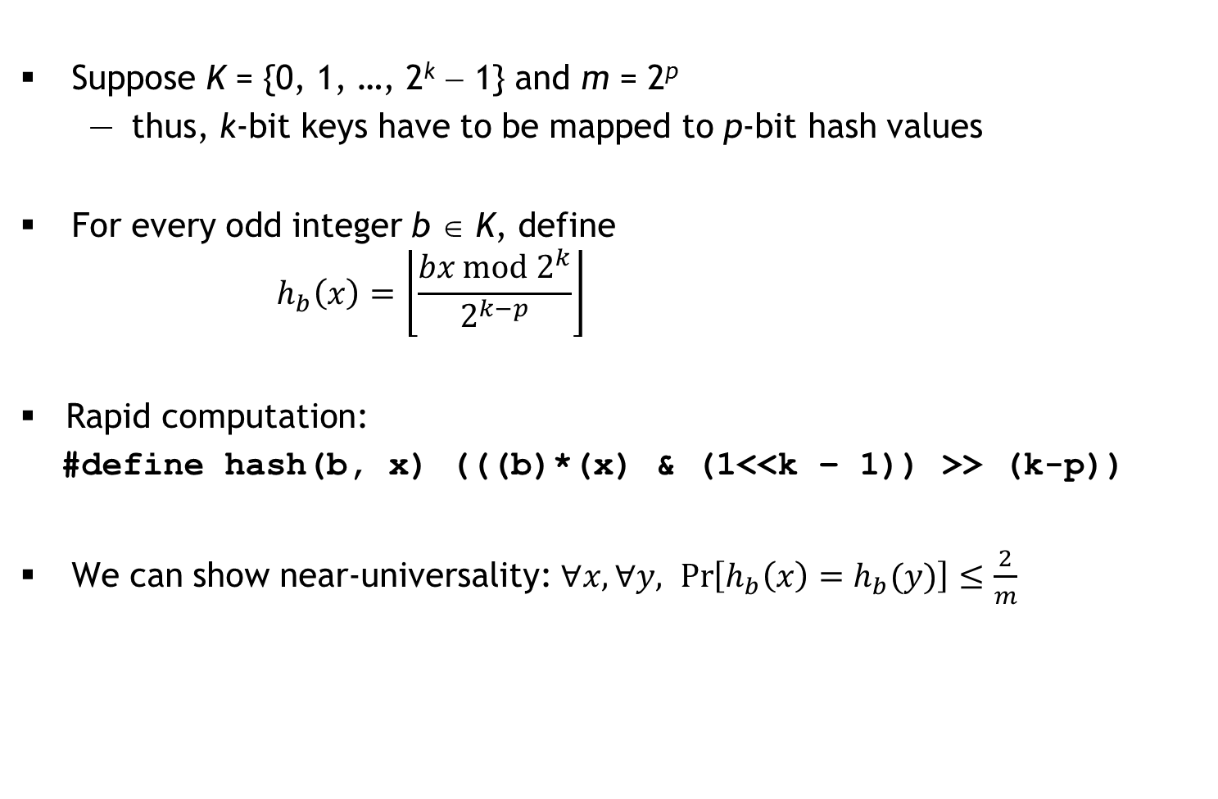
Binary Multiplicative Hash Family
Suppose K = {0, 1, …, 2^{k} − 1} and m = 2^{p}
thus, k-bit keys have to be mapped to p-bit hash values
For every odd integer b ∈ K, define
$$h_{b}\left(x\right)=\left\lfloor \frac{bx mod 2^{k}}{2^{k−p}}\right\rfloor$$
Rapid computation:
#define hash(b, x) (((b)*(x) & (1<<k – 1)) >> (k-p))
We can show near-universality: $∀x, ∀y, \operatorname{Pr}\left[h_{b}\left(x\right)=h_{b}(y)\right]≤\frac{2}{m}$

